Slide 1
Distributed Computing Internet of Things (IoT)
Dr. Barsha Mitra
CSIS Dept, BITS Pilani, Hyderabad Campus

Slide 2
IoT for Ubiquitous Computing
IoT is a natural extension of the Internet
foundation of IoT is radio-frequency identification (RFID)
RFID enables discovery of tagged objects and mobile devices by browsing an IP address
objects include electronic devices, humans, animals, food, clothing, homes, vehicles, commodities, trees, hills, landmarks

Slide 3
Enabling and Synergistic Technologies
supportive technologies are divided into 2 categories:
enabling technologies –
build up the foundations of IoT
eg., - tracking (RFID), sensor networks, GPS
synergistic technologies –
play supporting roles
eg., - biometrics, artificial intelligence, computer vision, robotics, telepresence

Slide 4
Architecture of the Internet of Things
3-layer architecture
top layer: consists of applications
bottom layers: represent various types of sensing devices like RFID tags, ZigBee or other types of sensors, and road-mapping GPS navigators
signals or information collected at these sensing devices are linked to the applications through the cloud computing platforms at the middle layer
sensors and filters are used to collect raw data
compute and storage clouds and grids process the data and transform it into information and knowledge formats
sensed information is put together for a decision-making system

Slide 5
Architecture of the Internet of Things

Slide 6
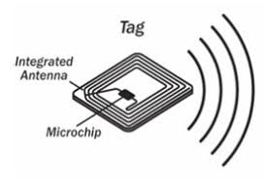
Radio-Frequency Identification (RFID)
RFID is applied with electronic labels or RFID tags on any object being monitored or tracked
identify and track objects using radio waves or sensing signals
Components of RFID h/w
RFID tag - tiny silicon chip attached to a small antenna
2 major parts
integrated circuit for storing and processing information, modulating and demodulating radio-frequency (RF) signal etc.
antenna for receiving and transmitting radio signals

Slide 7
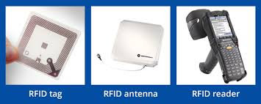
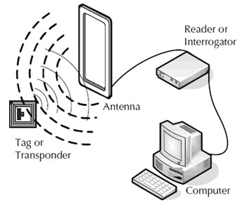
Radio-Frequency Identification (RFID)
Components of RFID h/w
Reader antenna –
used to radiate energy and then capture the return signal sent back from the tag
integrated with a handheld reader device or connected to the reader by cable
Reader –
device station that talks with the tags
may support one or more antennae

Slide 8
Types of RFID Tags
active RFID tags containing a battery and transmitting signals autonomously
passive RFID tags have no battery and require an external source to induce signal transmission
battery-assisted passive RFID tags require an external source to wake up the battery

Slide 9
Smart Buildings
enhance our lives with comfort, convenience, and security
reduce energy costs and environmental impacts
may include alarm systems, access controls, indoor climate controls, elevators
smart building - shopping mall, home, hospital, high-rise office tower
need monitoring and regulation of heating, air conditioning, lighting, and environmental changes
can oversee building security, fire suppression, and elevator operations
smart building technologies focus on bringing more detailed monitoring and sensing “awareness” to buildings

Slide 10
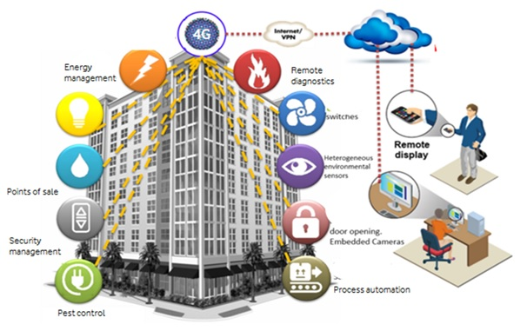
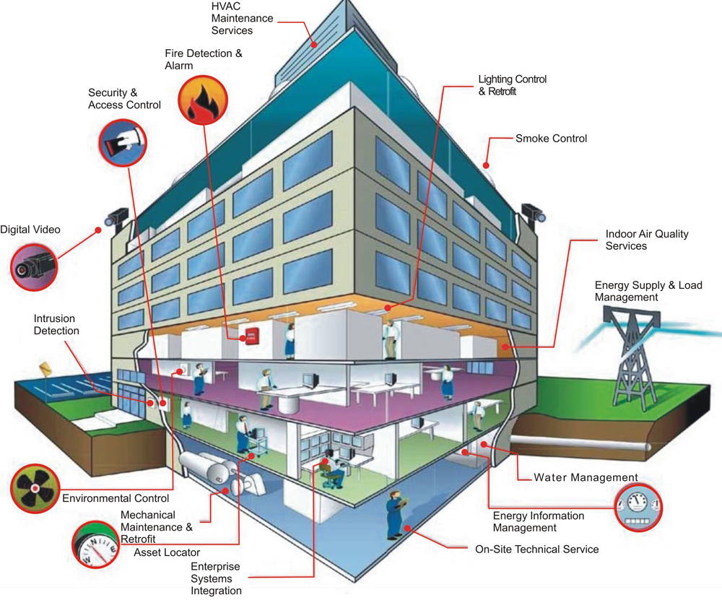
Smart Buildings

Slide 11
References
Kai Hwang, Geoffrey C. Fox, and Jack J. Dongarra, “Distributed and Cloud Computing: From Parallel processing to the Internet of Things”, Chapter 9.
https://www.exchangecommunications.co.uk/products/smart-building-and-cities/smart-buildings.php
https://blog.econocom.com/en/blog/smartbuilding-and-bms-a-little-glossary/
https://www.security-warehouse.com/rfid-iot/rfid-antenna.html
https://www.scnsoft.com/blog/iot-for-inventory-management
https://www.autodesk.com/products/eagle/blog/rfid-works-antenna-design/

Slide 12
Thank You

